Slide 1
Connection in a time of "social distancing"

Slide 2
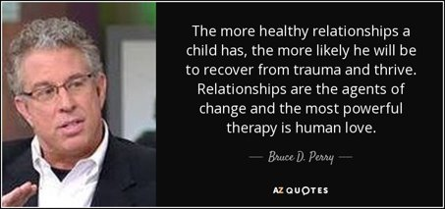
Why do we focus on connection?

Slide 3
Questions we discussed in our teams...
How can we keep connected with our students, and with each other, during this time apart?
How can we enable our children to stay in touch with each other safely?
Are there any routines or rituals that we use in school to build community that we can replicate virtually?
How can we deepen our relationships with parents and families, so they feel supported and less alone? Which families would appreciate this, and which might not?
What do nurture principles look like in a "socially distant" world?
How can we incorporate playfulness and silliness into our virtual work?

Slide 4
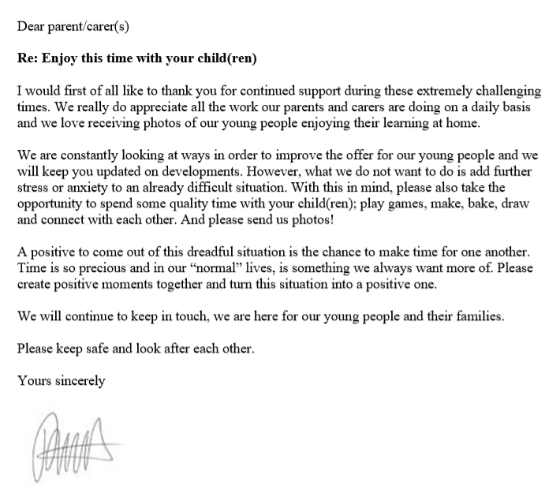
Removing the pressure on parents to homeschool

Slide 5
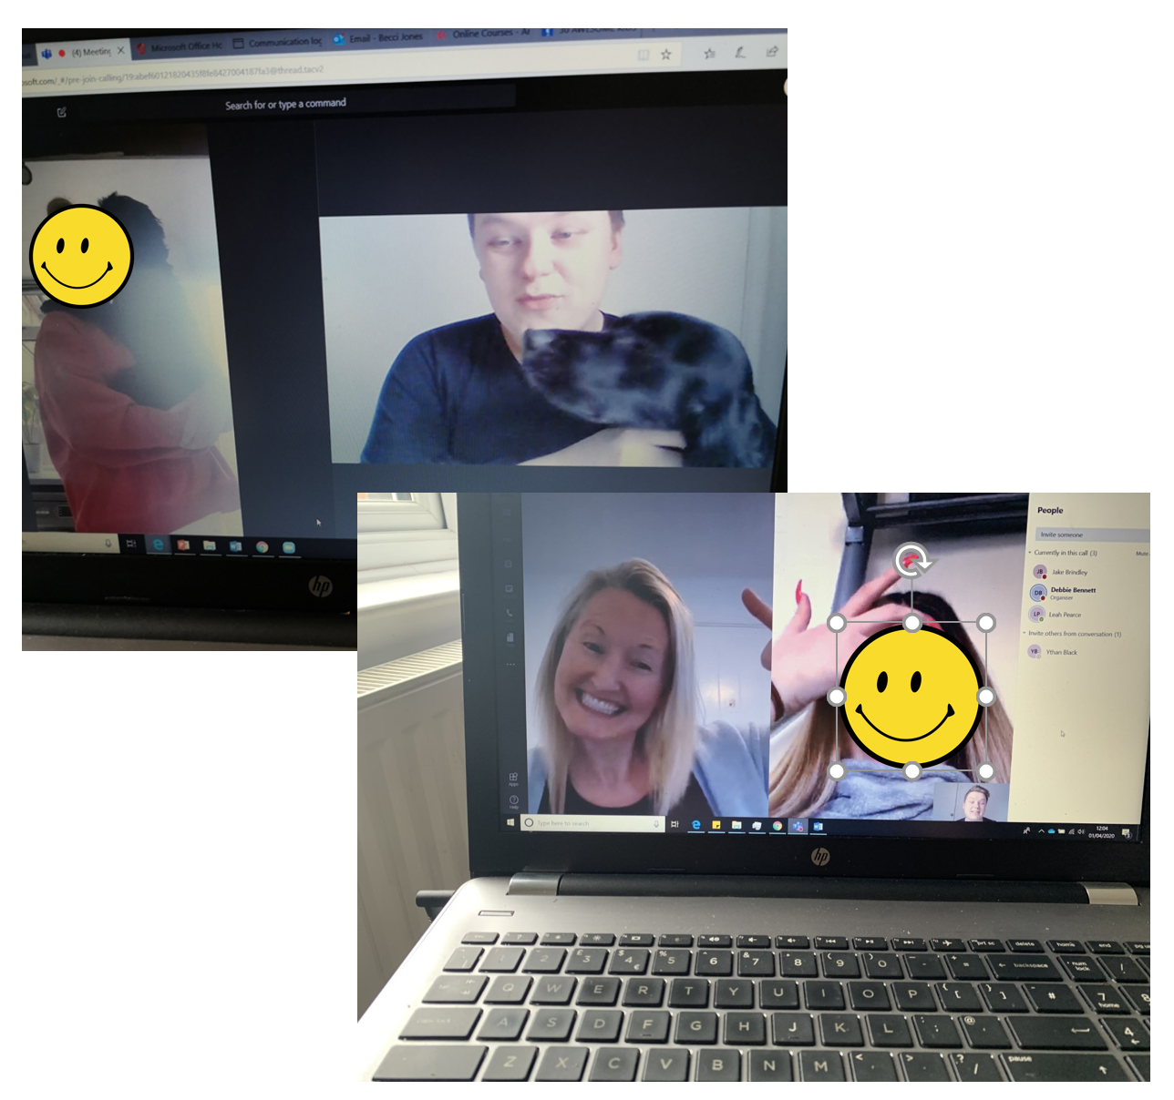
Video calling just to chat NB safeguarding and union guidance...

Slide 6
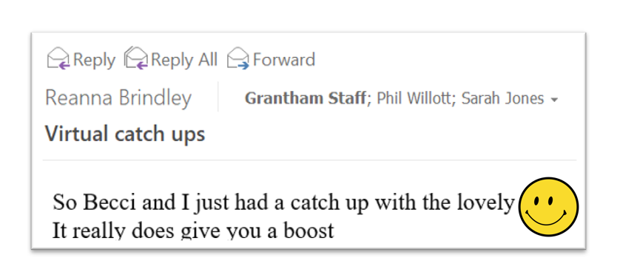
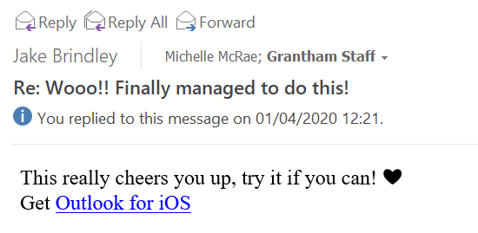
Video calling just to chat NB safeguarding and union guidance...

Slide 7
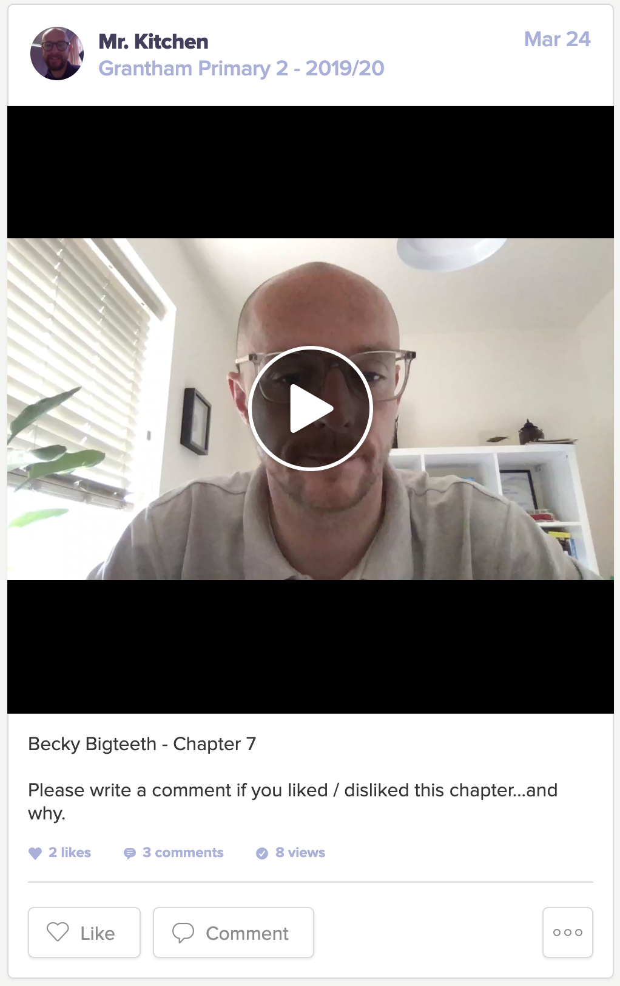
Online class chats about stories

Slide 8
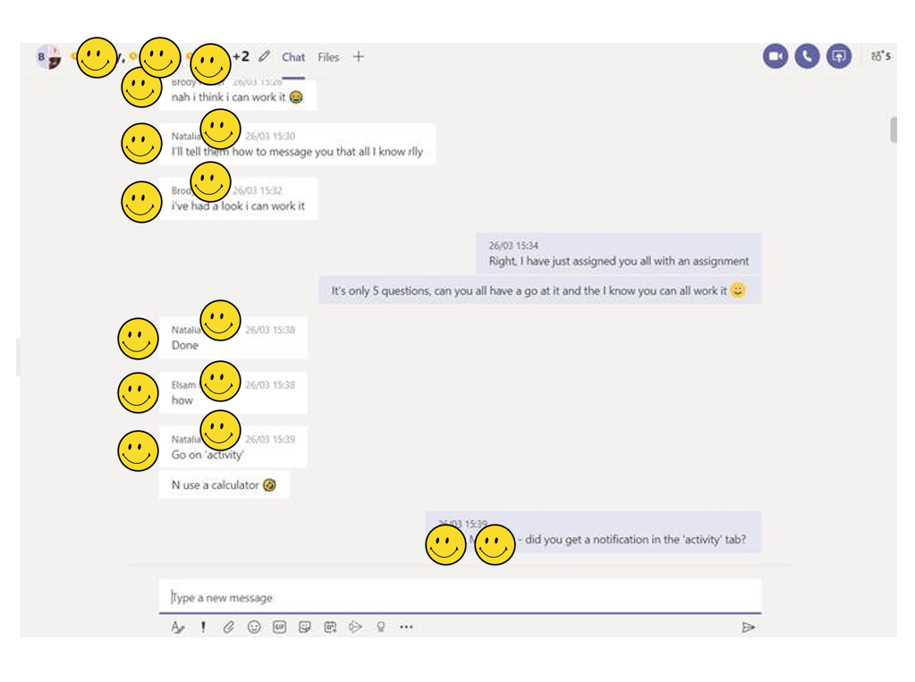
Online class chat groups

Slide 9
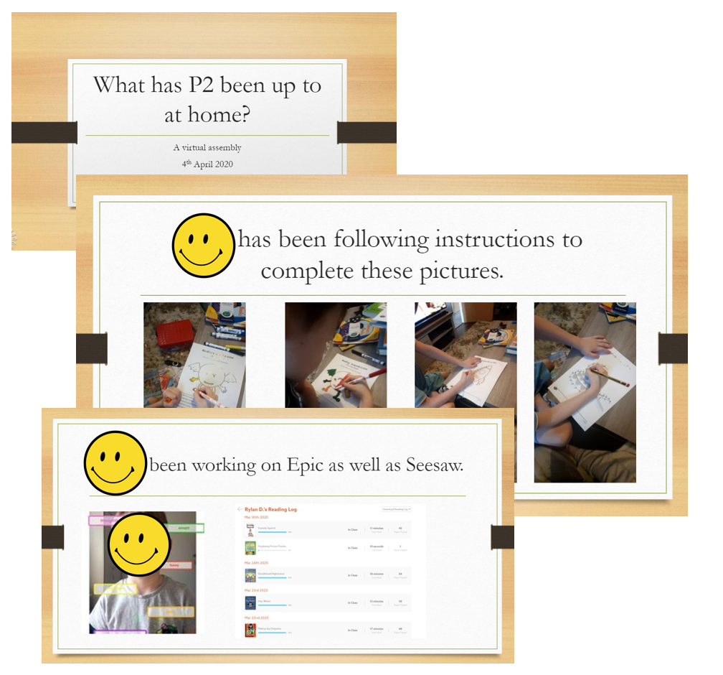
Virtual celebration assemblies

Slide 10
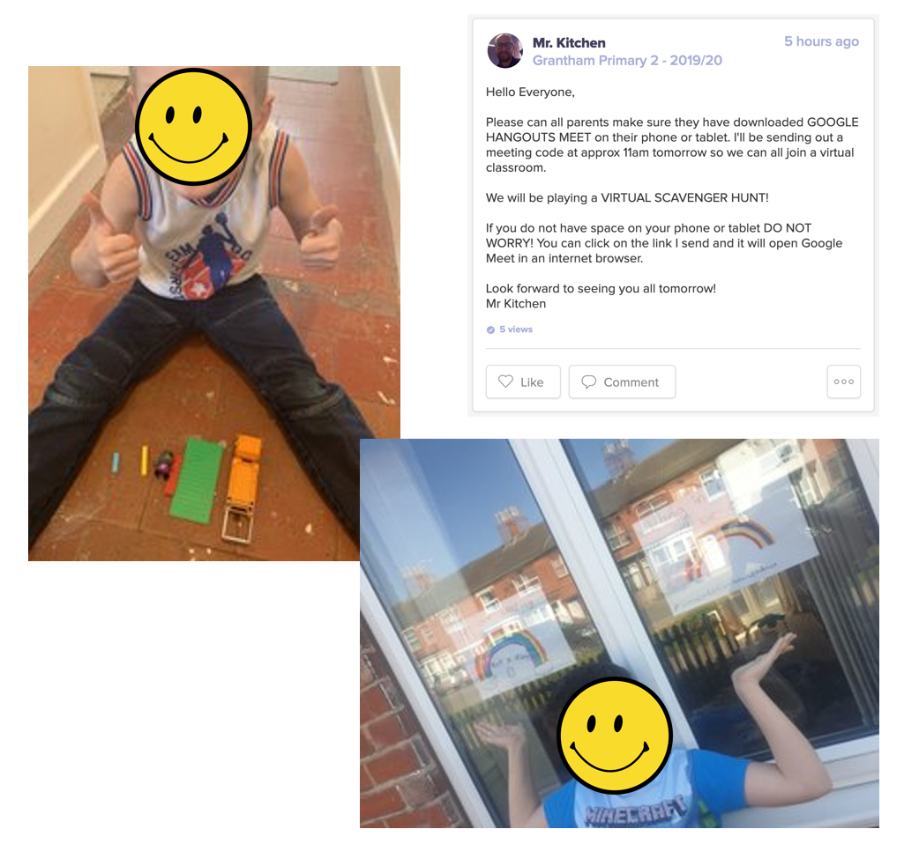
The importance of play and silliness a rainbow scavenger hunt

Slide 11
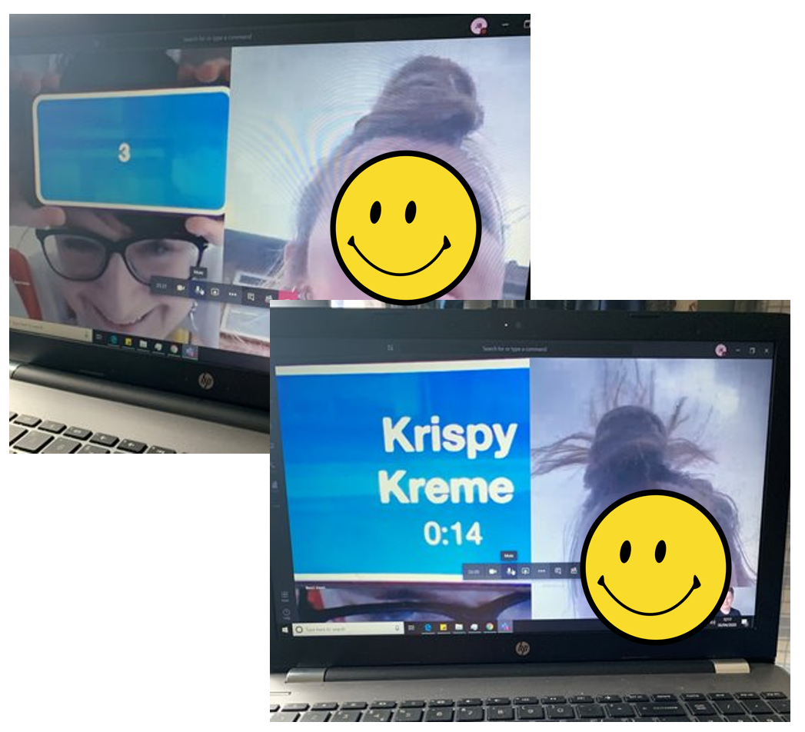
The importance of play and silliness Head's Up

Slide 12
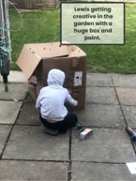
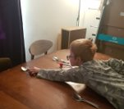
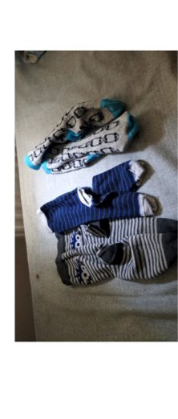
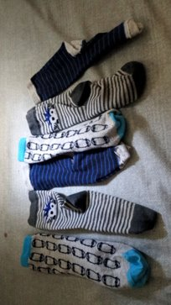
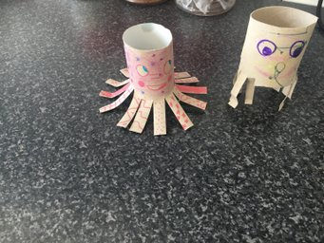
The importance of play and silliness supporting parents with play

Slide 13
The importance of play and silliness
Some other things we have planned...
Lego challenges
Team quizzes with your family
Drawing and art challenges
Silly face competition
https://www.thriveapproach.com/
https://theraplay.org/

Slide 14
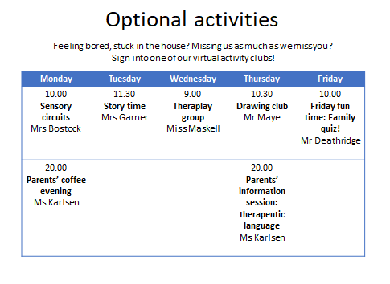
Optional activities and support for families

Slide 15
Stay in touch... And give me your ideas!

