Slide 1
Why are we doing this?
Cath Kitchen
ckitchen@nhoe.org.uk
@CathCathKitchen
Notes:
Key thing for me - why are we doing this? It is not about the education per se, it is about maintaining contact, giving our students a sense of belonging, checking in and safeguarding them and making sure that they still feel part of their learning community. This is what we do in AP so successfully - we know all of our children and young people really well, we know and have engaged their families which is critical to the successful partnership in supporting our students - relationships - and maintaining them - is the most important task of all
Social distancing is physical - it is not your mind and soul

Slide 2
Key questions to be asking yourselves:
What skills have my staff already got?
What does ‘free’ mean?
How do I know it is safe?
How are staff doing?
Notes:
whatever you have now that staff can use and are familiar with - USE IT - don’t try and change it and expect people to understand how to use it. Recognition that this is a shift in skill set for teachers - what works for children in their class currently may be different in the online environment.
If you want to introduce something like Google, it needs to be carefully planned and strategically introduced in a measured way (own example)
Staff training for using online platforms - plenty out there (give examples)
Whatever you do and whatever you use - do your due diligence on safeguarding and data protection checks - don’t rush into something just because someone told you it was good and it is free. Be careful with working out what is ‘free’? 30 days? Until the summer? Forever? Check the terms and conditions. ‘Free cat - need to feed it, take the vet and be careful where it does its business’!!
Only use software that you are familiar with - pupils and staff. If you want to introduce new, then do your due diligence, ensure that you know how it works, check the training that will be provided to staff - direct or via video clips. Will it make their work easier? Or will it add to their stress?
Quality assurance of products - edtech platforms - need to know tech requirements, what training is required etc, are there any tutorials or support for parents who are helping their child. Who is the data controller of the software - teachers?parents? Need to check privacy notices. Edtech uses user reviews
In all of this, we have to look after the wellbeing of staff - teaching this way is quite intensive, you don’t have the opportunities to unload your worries about students with colleagues in the same way.
Be realistic about what you are expecting your pupils to do - don’t overload them - they will then feel anxious and stressed and may act out at home and then the parents have to deal with it. Lets face it, we are not going to be delivering all of the content we had planned for the summer term?
Consider teaching for just a half day and leave half day with directed activities.
Have different ways to check in with staff - whole staff meetings, team meetings, curriculum group meetings,
individual supervision sessions can be done by phone.
Think about staff wellbeing packages - can you afford to buy into any schemes?
Think about the CPD you ask people to do e.g. is it all about work? What about something that is of personal interest to them?
And don’t forget to say thank you

Slide 3
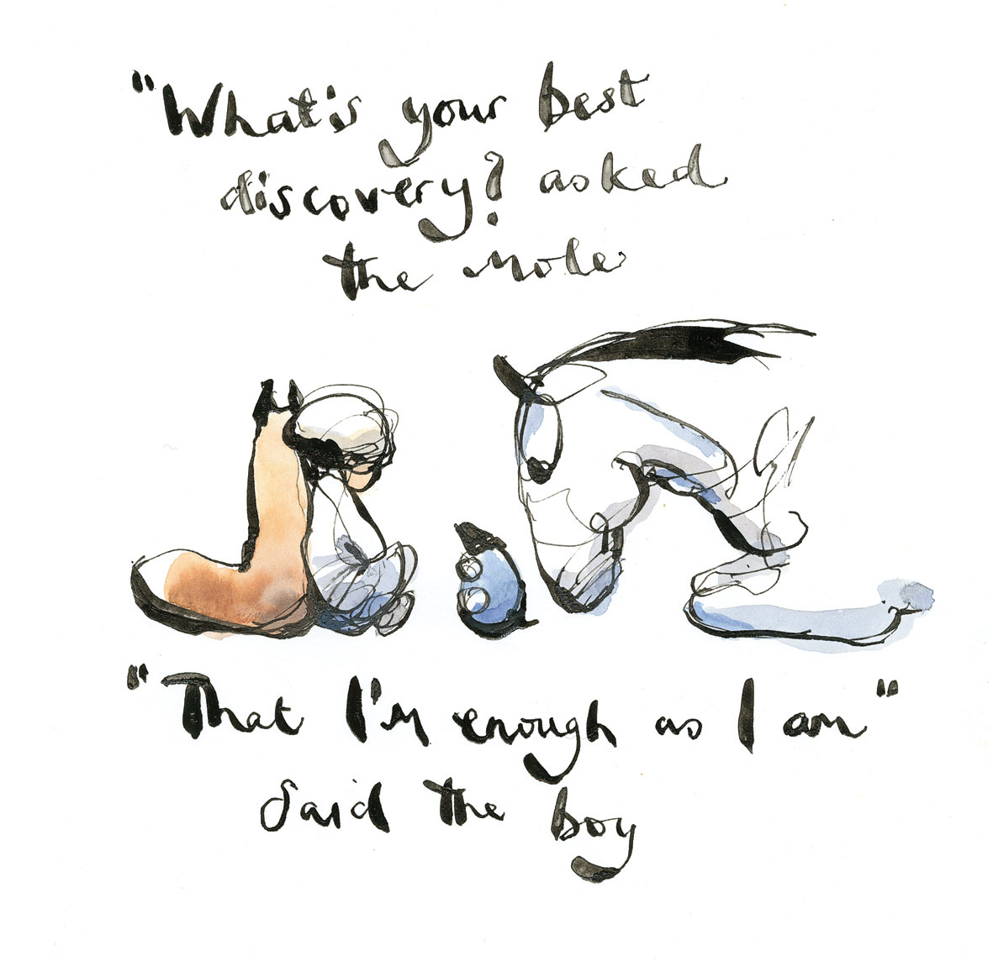
Notes:
Don’t know if you have come across this book - The Boy, the mole, the fox and the Horse - by Charlie Mackesy but it is a picture about with lots of quotes about friendship and what really matters in the bigger scheme of things.
It is too easy for us to get caught up on the treadmill of wanting to do this and that, but the reason that you are here, is that you are genuinely interested in children and young people and want to make a real difference to them at this challenging times.
So I just wanted to share this quote and I think that we all need to bear this in min.

