Slide 1
YouTube distance learning
Hannah Wright
TBAP Unity Academy
Miss M’s Science World
@missmsciworld
Notes:
Hello. My name is Hannah Wright and I am the head of science at TBAP Unity Academy Wisbech. I teach both art and science and am actually a Fine Art and Illustration graduate. I think this gives me a unique perspective to be creative and innovative in science lessons. I’m going to share with you some of what I do online. First things first I’m going to tell you why I started using YouTube.

Slide 2
Music
My teaching journey started in a wonderful SEMH school called Trinity school that is now known as TBAP Unity Academy.
All of the learners had EHCP’s, all were very reluctant learners and most hated science because it was “boring”.
Pivotal point?
…she felt frustrated and angry with herself because she couldn’t understand what I was teaching. She said “you’ve gone over it loads and everyone else gets it so why don’t I? I feel like I’m trying really hard and I just can’t understand or remember what you’re teaching. It doesn’t sink in”
@missmsciworld
Miss M’s Science World
Notes:
My teaching journey started in a wonderful SEMH school called Trinity school that is now known as TBAP Unity Academy. All of the learners had EHCP’s, all were very reluctant learners and most hated science because it was “boring” or “difficult”. I will always remember what I consider the pivotal point in my teaching career. One day one of the girls stormed out of the lesson swearing and threw her book across the room. I left my teaching assistant in control of the class to go and find the girl and see what had made her flip from calm and working to storming out and swearing at us all. She opened up and said that she felt frustrated and angry with herself because she couldn’t understand what I was teaching. She said “you’ve gone over it loads and everyone else gets it so why don’t I? I feel like I’m trying really hard and I just can’t understand or remember what you’re teaching. It doesn’t sink in.”

Slide 3
Finish the song lyric…
Working 9 to 5 ___________
…take a sad song, and make it better _________________ then you can start to feel better.
Is this the real life? _______________
@missmsciworld
Miss M’s Science World
Notes:
So let’s pause that story a second…Do you ever wonder how you can’t remember what you did last week but can remember all the lyrics to a song you last heard 10 years ago?
A few words or a tune as a prompt and we are all singing along to ‘Hey Jude’. Music has this amazing ability to stick in our brains. Songs we’ve not heard for years can be recalled word by word as soon as you hear the opening chord or the first few words.

Slide 4
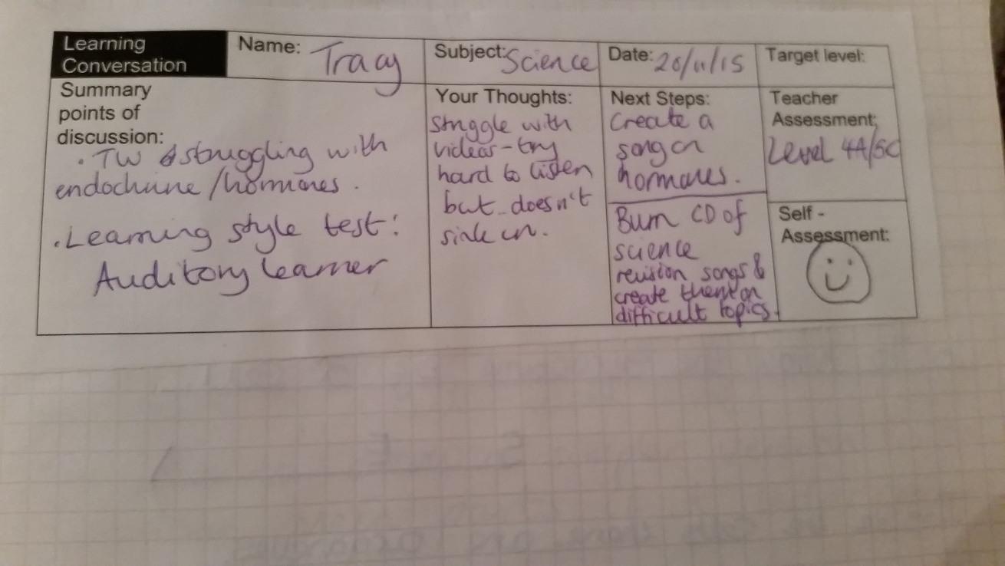
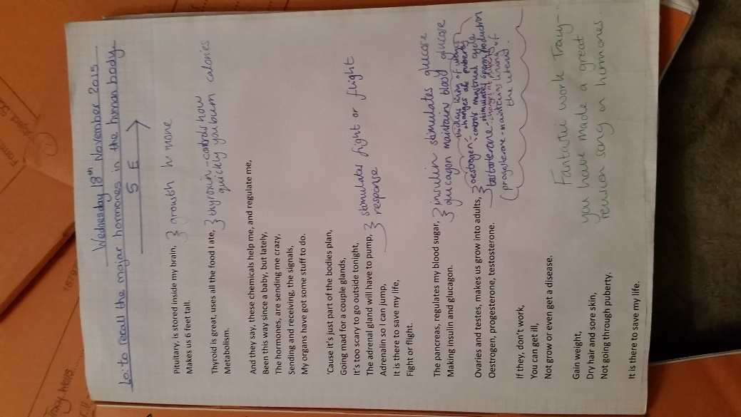
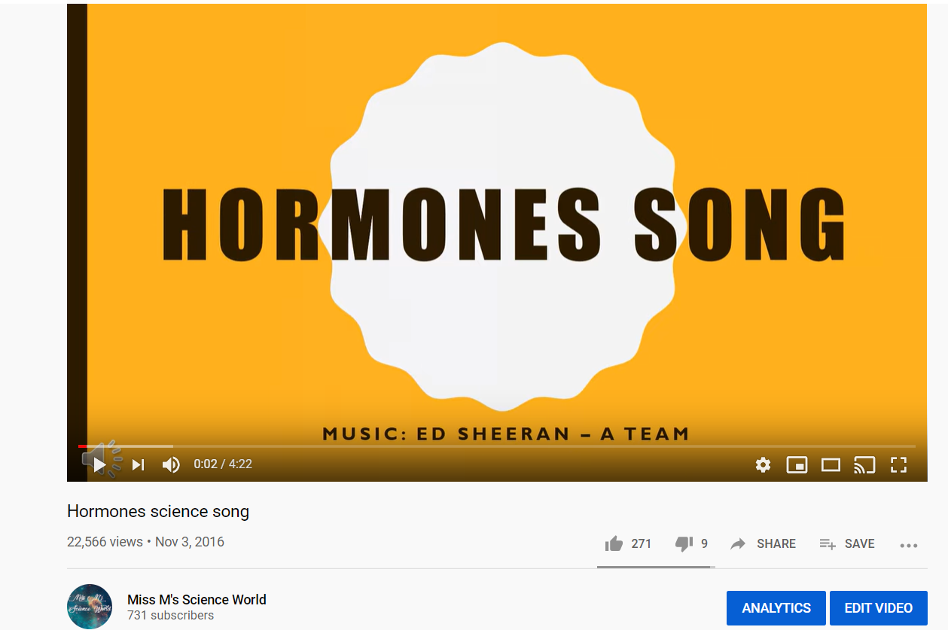
This then prompted a learning conversation – the most valuable tool at any teachers disposal. I only had chance to scribble a few things down at the time but that conversation was my promise to try something new for that learner.
@missmsciworld
Miss M’s Science World
Notes:
After this comment from the female learner, this then prompted a learning conversation – the most valuable tool at any teachers disposal. I only had chance to scribble a few things down at the time but that conversation was my promise to try something new for that learner.

Slide 5
Why music?
Repetition – when you practice something you strengthen the network of neurons in your brain.
Rhyme and pattern – when writing poems or songs, both the number of beats and the rhymes themselves provide clues as to what the next line is.
Enjoyment – when we are emotionally excited by something the brain assumes that the information is important and works harder to store it. Your brain is going to assign more significance to music than a boring page of writing.
@missmsciworld
Miss M’s Science World
Notes:
Why music?
Repetition – when you practice something you strengthen the network of neurons in your brain.
Rhyme and pattern – when writing poems or songs, both the number of beats and the rhymes themselves provide clues as to what the next line is e.g Humpty Dumpty sat on a wall…
You know you’re after a word that rhymes with wall. It lessens the load on your brain which now has fewer possibilities for the answer.
Enjoyment – when we are emotionally excited by something the brain assumes that the information is important and works harder to store it. Your brain is going to assign more significance to music than a boring page of writing.

Slide 6
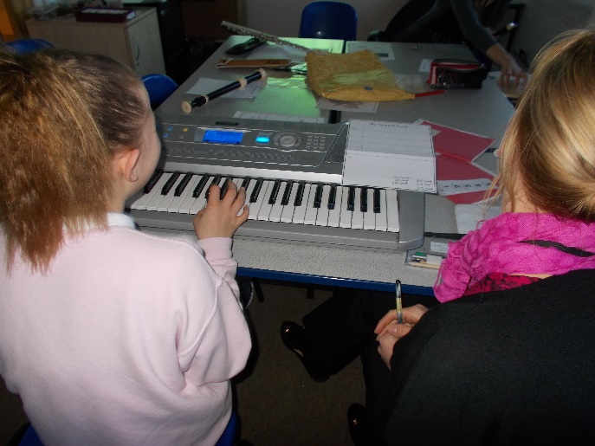
Music can help engage disengaged learners e.g they may enjoy rap music so put the information in rap form?
Everyone loves a song and knows all the words to it so why not adapt this to meet your subject?
Dyslexic learners – is a dyslexic learner going to sit and look at revision cards as colourful and differentiated as they are?
@missmsciworld
Miss M’s Science World
Notes:
Music can help engage disengaged learners e.g they may enjoy rap music so put the information in rap form? I have had learners make raps to beats found on YouTube and present it to the class. A group of learners could use instruments or their voices and collaborate together. This is what I used to do with my learners. It’s a very unconventional science lesson. Everyone loves a song and knows all the words to it so why not adapt this to meet your subject? Dyslexic learners – is a dyslexic learner going to sit and look at revision cards as colourful and differentiated as they are? Probably not. They are however likely to sit listening to some music, especially if they helped write it and enjoyed making it. I have first hand experience of this and it’s another reason I continued to make revision songs.

Slide 7
After what felt like a lifetime developing relationships with these learners through music we came to exam season…
During the exam the learners were singing lyrics at their scribes.
I have learners that listen to the songs daily and know all of the lyrics. Learners will engage with you as you’ve made the effort to be a bit braver by putting yourself out there.
@missmsciworld
Miss M’s Science World
Notes:
After what felt like a lifetime developing relationships with these learners through music we came to exam season…During the exam the learners were singing lyrics at their scribes. They knew the answers to so many questions because “ooh it says telescopes so let me sing the lyrics.” I have learners that listen to the songs daily and know all of the lyrics. Learners will engage with you as you’ve made the effort to be a bit braver by putting yourself out there.

Slide 8
@missmsciworld
Miss M’s Science World
Notes:
Some of the feedback from learners all over the country has been really positive. They say that this makes learning easy, it’s catchy so it’s easy to remember, that it works for their revision style and that it’s simplified complicated topics for them.
Now I’m not saying you’re all going to start singing on YouTube but this is just one of the ways it can be used and how I started my journey with it.

Slide 9
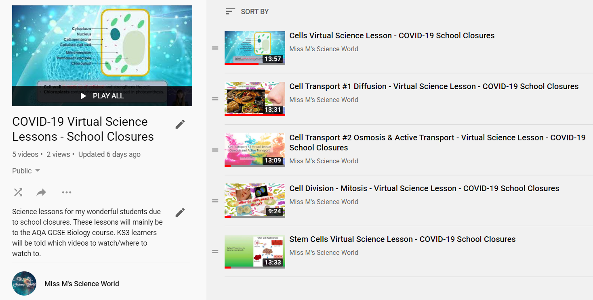
@missmsciworld
Miss M’s Science World
Notes:
Since the school closures, TBAP has gone completely online where possible. I made the decision to create virtual science lessons to deliver to learners. Every other day a video goes live on YouTube. The video features me explaining a topic to learners and getting them to pause the video and complete tasks. Most learners will have been sent home with packs of work, which is of course appropriate for those without IT access however, we are relying on parents to support these young people. Sometimes they may be able to talk to teachers but not necessarily when they are sitting down doing that specific subjects work. Some learners won’t be able to join a live lesson due to other siblings using the laptop so this means they never miss out as they can do the lesson whenever is convenient for them. This format allows learners to have teacher interaction/correction of any work you ‘set’ in the lesson and is the closest thing to a lesson that I can provide to my learners. The next day I use Microsoft Teams and discuss the video and work with learners. How did they do? Were there any areas they really struggled with? I may then set up an online lesson using another system such as Seneca or Learning by Questions – but these are topics for another day. I usually have a set of exam questions/activities for learners to do based on the previous day’s YouTube video. I am essentially asking them to apply the knowledge they learnt from the video to a question or test situation. This format has been really successful at TBAP and learners are engaged and ready at 9am for the video to premiere.

Slide 11
Notes:
I don’t do anything fancy…
I take my PowerPoint’s and record audio and visual over the top. I’ve made a simple guide on how to do this. Most of us will have access to Microsoft PowerPoint and a webcam. This doesn’t require any special skills or software particularly as again, most of us use PowerPoint from day to day. You have to consider activities – what activities do you want your learners to do? Fill in the blanks, questions, maybe a research activity afterwards? For me it was important to have my webcam camera film my face as many of our learners are autistic and will benefit from physically seeing me rather than just hearing me. Because the video has to be less than 15 minutes, you as a teacher have to simplify complex topics and really focus on what you want learners to know. It’s a small nugget of knowledge for your learners.

Slide 12
Challenges?
IT access
Are learners watching the videos and doing the activities?
@missmsciworld
Miss M’s Science World
Notes:
There are of course challenges with using YouTube for distance learning whether it’s a virtual lesson or a revision song. Some learners don’t have online access and unfortunately I don’t have a solution for this. Are learners watching the videos and doing the activities? Well are they doing the paper based work you sent them? YouTube is visual, it can be colourful and humorous, you could do something practical on the video or explain something with cutting-edge PowerPoint animations. You can make learning more active and stimiulating than sitting with paperwork. It’s not perfect but it’s in my opinion better.

Slide 13
Future
Revision
Cover work
Excluded learners
@missmsciworld
Miss M’s Science World
Notes:
Going forward these videos will be perfect for cover work. Rather than leaving worksheets for a colleague to complete with learners, who often play up and say they don’t understand or “we’ve not learnt this” they can essentially click play and support learners through this virtual lesson instead. Learners who are unable to come into school perhaps due to anxiety can be virtually taught. Likewise, excluded learners can also access a lesson rather than being sent a pack home which let’s face it, teaching staff often rush around trying to get things together for. There’s a lot of potential here with YouTube. Those excellent lessons that you create can be there forever rather than doing a live meeting that won’t get to be seen again. Play around with it and most importantly embrace something new and creative into your practise.

Slide 14
Thank you for Listening
@missmsciworld
Miss M’s Science World

